Slide 1
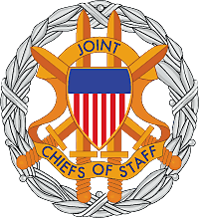
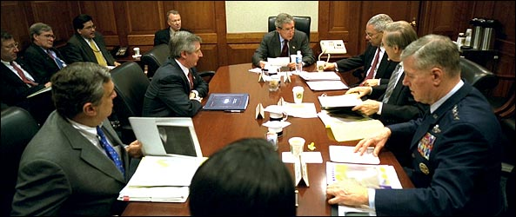
Civil Military Operations
and the
Fundamentals of Joint Operations

Slide 2
Overview
Components of National Security Organization
Roles and Functions of the JCS
Chain of Command
Fundamentals of Information Operations
How to Access Joint Learning Resources

Slide 3
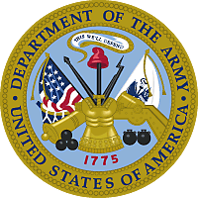



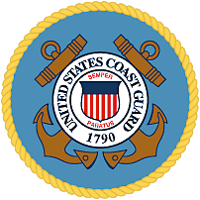
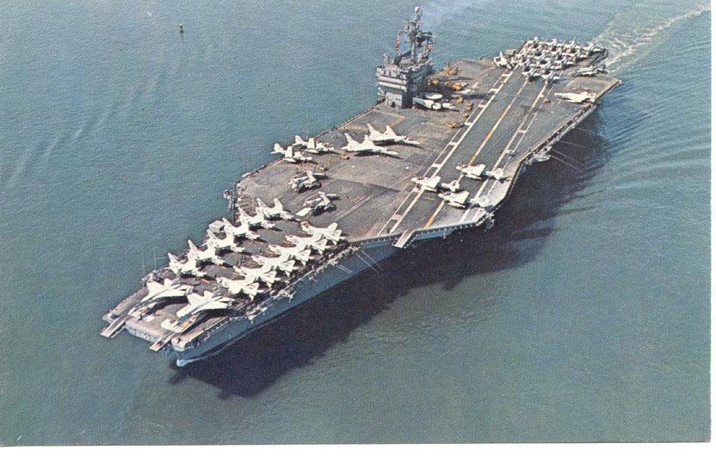
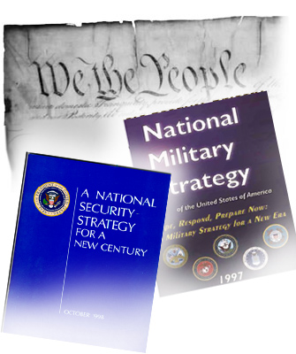
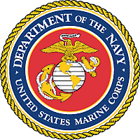
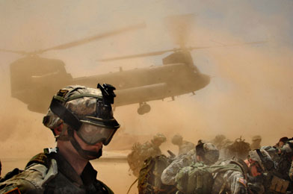
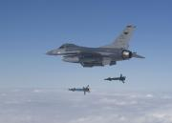
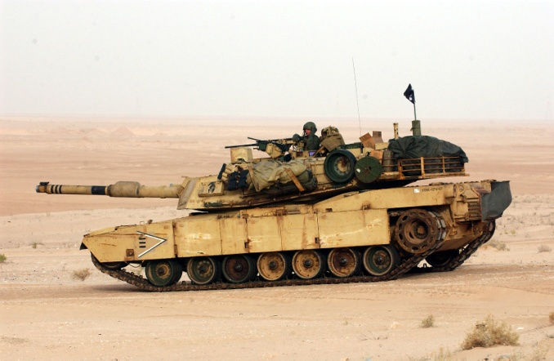
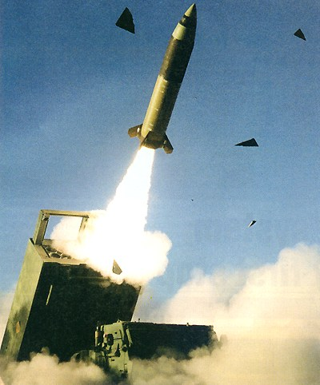
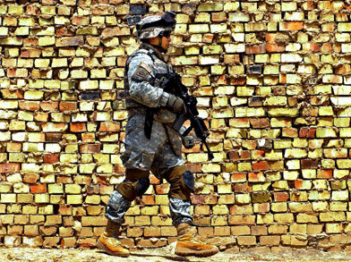
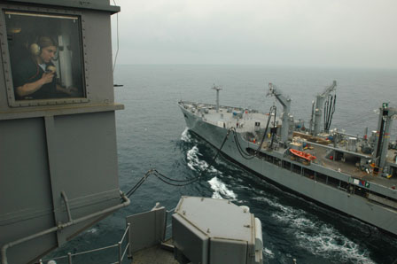
American Military Operations
Photo By: Army-Technolgy.com
Photo By: Richard Miller, BMCS, USNR (Ret)
Photo By: Answers.com
Photo By: Army-Technolgy.com
Photo By: SSG Russell Klika
Photo By: Photo’s Mate Airman Jimmy C. Pan, USN
Notes:
Show the attached slide for 1 Min.
Ask the Question, What is the Nature of American Military Power?
Let the students talk about the question for about 4 Minutes
Close out the discussion, but let the students know you will come back to the question again.

Slide 4




National Security Council
President of the United States
Vice President
Secretary
of
State
Secretary
of
Defense
Non-Statutory Members: Secretary of the Treasury
Assistant to the Secretary for National Security Affairs
Statutory Advisors: Director of National Intelligence
Chairman, Joint Chiefs of Staff
Notes:
This slide reflects the civil/military national security structure.
The National Security (NSC): the NSC Council is not a product of the U.S. Constitution, it is a product of the 20th Century and globalization. The NSC was established by the National Security Act of 1947, amended by the National Security Act Amendments of 1949. Later in 1949, as part of the Reorganization Plan, the NSC was placed in the Executive Office of the President.
There are four statutory members to the NSC:
President of the United States: Article II of the Constitution dictates that the President must defend and preserve the Constitution of the United Stares – He uses the National Security Council as a means to develop policy.
Vice President of the United States (VP): Article I, Section 3 identifies the VP as President of the Senate However he is a key advisor to the President on the development of national security policy.
Secretary of State (DOS): The Secretary serves as a principal adviser to the President in the determination of U.S. foreign policy and in recent decades has become responsible for overall direction, coordination, and supervision of interdepartmental activities of the U.S. Government overseas, all of them except for certain military activities. The Secretary also performs such duties as the President is required, in accordance with the U.S. Constitution relating to correspondence, commission, or instructions to U.S. or consuls abroad, and to conduct negotiations with foreign representatives.
Secretary of Defense (Sec Def): The Sec Def is the principal defense policy adviser to the President and is responsible for the formulation of general defense policy and policy related to all matters of direct concern to the Department of Defense, and for the execution of approved policy. Under the direction of the President, the Secretary exercises authority, direction and control over the Department of Defense.
Non- statatory members of the NSC - Each President is responsible for building the NSC that reflects his personal management style. This is done by incorporating additional players into the NSC. National Security Presidential Directive 1 incorporated the following staff sections into the NSC
Department of the Treasury.
Assistant to the Secretary for National Security Affairs.
There are two statutory advisors to the NSC:
Director, National Intelligence.
Chairman, Joint Chiefs of Staff

Slide 5
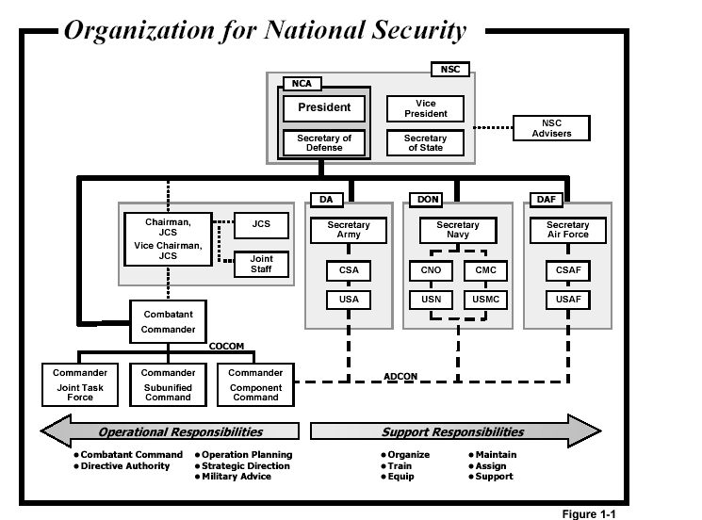
Organization for National Security
Notes:
- On the last slide we discussed the NSC, but what about the military portion of our national security network?
This slide reflects the military instrument of power, the chain of command and the responsibilities the Services and the Combatant Commander.
Notice the relationship between the Chairman JCS and the Combatant Commander. The Chairman JCS, is principle military advisor to the President, Sec Def and NSC. But the Combatant Commander’s chain of command is directly thru the Sec Def to the President. This change is a result of the 1986 Defense Reorganization Act (a.k.a Goldwater/Nichols).
The Goldwater/Nichols act forced the Services to accept the multi-dimensional challenges of the 20th Century. These challenges forced the Services to operate as a fully integrated joint team in combat and noncombatant operations. To support the “joint warfare is team warfare” concept each component must fully understand their roles and relationships within the system.
The support responsibilities of the Services: The Services have the principal responsibility to organize, train, equip, assign and support and maintain forces. These forces are then employed by a Combatant Commander.
The operational responsibilities of a Combatant Commander; In addition to employment of combat forces the combatant commander is responsible for operational planning, strategic direction, and providing military advice.

Slide 6
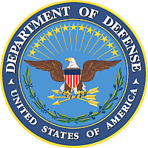
Organization for National Security
CHAIN
OF COMMUNICATION
CHAIN
OF
COMMAND
Unified
Combatant
Commanders
RECRUIT - TRAIN - EQUIP
PROVIDE
FORCES
Notes:
Simply speaking the CJCS acts as a communications link between the military’s senor leadership and our civilian chain of command.
Operational Branch: President, through the SECDEF, to the unified commanders for missions and forces assigned to their commands
Admin/Support Branch (Administer, Train, Equip, Recruit, Support, etc): President, through the SECDEF to the Secretaries of the Military Departments, then through the Chiefs of the Services, for their forces not specifically assigned to combatant commanders
Missions are communicated via the operational branch of the national chain of command

Slide 7
Military Power?
What is the nature of American Military Power?
Notes:
Given the information on the previous slides, what do the think the nature of
American Military Power is? “American Military Power” operates for and
under the conditions determined by the people through their elected
representatives. This political context establishes the objectives and limits of
legitimate military action in peace, crisis, and conflict in the United states and
abroad.” (JP1, I-4)

Slide 8
Values of Joint Warfare
JOINT WARFARE
VALUES
INTEGRITY
COMPETENCE
PHYSICAL COURAGE
MORAL COURAGE
TEAMWORK
Notes:
Team warfare requires team values; American military service is based on values that US military experience has proven to be the bedrock of combat success. These values adhere to the most idealistic societal norms, are common to all the Services, and represent the essence of American military professionalism.
- Integrity: The foremost value is integrity. It is the cornerstone for building trust. American Service men and women must be able to rely on each other, regardless of the challenge at hand; they must individually and collectively say what they mean and do what they say. Integrity inspires confidence in others to carry out assigned tasks and is a fundamental requirement for building effective teams.
- Competence: Courage is at the core of the profession of arms and of the relationship of the profession with the American people. Competent performance includes both the technical competence to perform the relevant task to standard as well as the ability to integrate that skill with others according to joint doctrine.
- Physical Courage: Defines warriors. The United States of America is blessed with its Soldiers, Sailors, Airmen, Marines, and Coast Guardsmen, whose courage knows no boundaries. Even in warfare characterized by advanced technology, individual fighting spirit and courage remain the inspiration for teamwork.

Slide 9
Values of Joint Warfare
JOINT WARFARE
VALUES
INTEGRITY
COMPETENCE
PHYSICAL COURAGE
MORAL COURAGE
TEAMWORK
Notes:
- Moral courage: Moral courage is also essential in military operations. This includes the willingness to stand up for what one believes to be right even if that stand is unpopular or contrary to conventional wisdom. Other aspects of moral courage involve risk taking and tenacity: making bold decisions in the face of uncertainty, accepting full responsibility for the outcome, and holding to the chosen course despite challenges or difficulties.
- Teamwork is the cooperative effort by the members of a group to achieve common goals. The Armed Forces of the United States — every military organization to the lowest level — are a team. Deterring adversaries, and when necessary, winning the Nation’s wars are the team’s common goals. Americans respond to and respect teamwork as an important value.

Slide 10
Fundamentals of Information Operations
Information Operations is the integrated employment
of electronic warfare (EW), computer network
operations (CNO), psychological operations (PSYOP),
military deception (MILDEC), and operations security
(OPSEC) in concert with specified supporting and
related capabilities, to influence, disrupt, corrupt or
usurp adversarial human and automated decision
making while protecting our own.
Notes:
Information is a strategic resource, vital to national security, and military operations depend on information and information systems for many simultaneous and integrated activities. Information operations (IO) are described as the integrated employment of electronic warfare (EW), computer network operations (CNO), psychological operations (PSYOP), military deception (MILDEC), and operations security (OPSEC), in concert with specified supporting and related capabilities, to influence, disrupt, corrupt, or usurp adversarial human and automated decision making while protecting our own. The purpose of this doctrine is to provide joint force commanders (JFCs) and their staffs guidance to help prepare, plan, execute, and assess IO in support of joint operations. The principal goal is to achieve and maintain information superiority for the US and its allies. The information environment is the aggregate of individuals, organizations, and systems that collect, process, disseminate, or act on information. The information environment is made up of three interrelated dimensions: physical, informational, and cognitive.
IO consists of five core capabilities which are: PSYOP, MILDEC, OPSEC, EW, and CNO. Of the five, PSYOP, OPSEC, and MILDEC have played a major part in military operations for many centuries. In this modern age, they have been joined first by EW and most recently by CNO. Together these five capabilities, used in conjunction with supporting and related capabilities, provide the JFC with the principal means of influencing an adversary and other target audiences (TAs) by enabling the joint forces freedom of operation in the information environment.
Capabilities supporting IO include information assurance (IA), physical security, physical attack, counterintelligence, and combat camera. These are either directly or indirectly involved in the information environment and contribute to effective IO. They should be integrated and coordinated with the core capabilities, but can also serve other wider purposes.
There are three military functions, public affairs (PA), civilmilitary operations (CMO), and defense support to public diplomacy, specified as related capabilities for IO. These capabilities make significant contributions to IO and must always be coordinated and integrated with the core and supporting IO capabilities. However, their primary purpose and rules under which they operate must not be compromised by IO. This requires additional care and consideration in the planning and conduct of IO. For this reason, the PA and CMO staffs particularly must work in close coordination with the IO planning staff.

Slide 11
Fundamentals of Information Operations
Where information environment overlaps with the physical world
Information systems and networks
key characteristics: computers and communications systems, and
supporting infrastructures
Physical
Dimension
Where information is collected, processed, stored, disseminated,
displayed, and protected
Duel nature – information itself and the medium
Links physical and cognitive dimensions
Key characteristics: information content and flow, information quality
Where automated decision making takes place
Informational
Dimension
Where human decision making takes place
Dimension of intangibles such as morale, unit cohesion, public
opinion, situational awareness
Key characteristics: perceptions, emotions, awareness, and
understanding
Cognitive
Dimension
Notes:
The Information Environment
The information environment is the aggregate of individuals, organizations, and systems
that collect, process, disseminate, or act on information. The actors include leaders, decision makers,
individuals, and organizations. Resources include the materials and systems employed to collect,
analyze, apply, or disseminate information. The information environment is where humans and
automated systems observe, orient, decide, and act upon information, and is therefore the principal
environment of decision making. Even though the information environment is considered distinct,
it resides within each of the four domains. The information environment is made up of three
interrelated dimensions: physical, informational, and cognitive.
(1) The Physical Dimension. The physical dimension is composed of the command
and control (C2) systems, and supporting infrastructures that enable individuals and organizations
to conduct operations across the air, land, sea, and space domains. It is also the dimension where
physical platforms and the communications networks that connect them reside. This includes
the means of transmission, infrastructure, technologies, groups, and populations. Comparatively,
the elements of this dimension are the easiest to measure, and consequently, combat power has
traditionally been measured primarily in this dimension.
(2) The Informational Dimension. The informational dimension is where information is
collected, processed, stored, disseminated, displayed, and protected. It is the dimension where the C2
of modern military forces is communicated, and where commander’s intent is conveyed. It consists of
the content and flow of information. Consequently, it is the informational dimension that must be
protected.
(3) The Cognitive Dimension. The cognitive dimension encompasses the mind of
the decision maker and the target audience (TA). This is the dimension in which people think,
perceive, visualize, and decide. It is the most important of the three dimensions. This dimension
is also affected by a commander’s orders, training, and other personal motivations. Battles and
campaigns can be lost in the cognitive dimension. Factors such as leadership, morale, unit
cohesion, emotion, state of mind, level of training, experience, situational awareness, as well as public opinion,
perceptions, media, public information, and rumors influence this dimension.

Slide 12
Accessing Joint Learning Resources
There is no studying the battlefield. It is then simply a case of doing
what is possible, to make use of what one knows and, in order to make
a little possible, one must know much.
- Marshal of France Ferdinand Foch,
Quoted in Marshall, Infantry in Battle, 1939
- Doctrine Networked Education and Training (DOCNET)
https://ca.dtic.mil/doctrine/default.htm
- Joint Electronic Library (JEL)
https://www.dtic.mil/doctrine/s_index.jsp
- Joint Staff Information Network (JSIN)
https://jdeis.js.mil/jdeis/index.jsp
Notes:
- Individually initiated education is essential to an officer because there is not time in a career to attend schools once a soldier is in the field, The American people and multinational partners expect US military competence in every aspect of warfare. Those who will lead joint forces must develop skill in orchestrating air, land, sea, space, and special operations forces into smoothly functioning joint teams.
- DOCNET courses are a series of online multimedia presentations of key Joint Doctrine information. The lessons are designed to enhance Joint Doctrine learning. Each DOCNET course has been drawn directly from doctrine without interpretation and is, therefore, an authoritative source of information for use by the Armed Forces of the United States and other Government professionals who require Joint Doctrine knowledge. DOCNET can be used as an information source, to supplement Professional Military Education, or for college credit.
Undergraduate college credit is available, free of charge, for the successful completion of any DOCNET course and its accompanying exam. The American Public University System, a nationally accredited online university system, will grant one undergraduate credit hour in the military science category for each DOCNET course completed.
- The Joint Doctrine, Education and Training Electronic Information System (JDEIS) Web Portal is managed for the Chairman of the Joint Chiefs of Staff (CJCS) by Joint Staff J-7 (Operational Plans & Joint Force Development). When fully operational, JDEIS replaces the Joint Electronic Library (JEL)

Slide 13
Practical Exercise

Slide 14
Summary
National security is Constitutionally based
Civilian nature of the National Security Council
Roles and functions
The chain of command
Nature of American Military Power
Joint Values
Fundamentals of information operations
Continued Education

